Slide 1

Unit 1Welcome to New York
Lesson 10-11
“Have you ever tried blintzes?”
For the 9th form

Slide 2
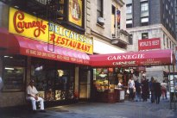
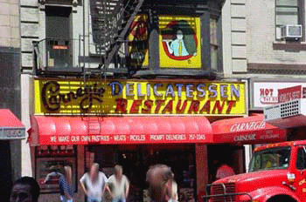
Have you ever tried blintzes?

Slide 3
Have you ever tried blintzes?
[S]
[i]
[a:]
[ts]
[a]
posh [poS] – прекрасный, шикарный
pickle [‘pikl] – рассол
argue [‘a:gju] – спорить
blintzes [blintses] – фаршированные блины
pastrami [pqs’trami] – копчёная говядина (бастурма)

Slide 4
Listen to the words and expressions which are used to describe restaurants and repeat them after the speaker. (ex. 2, p. 30)
noisy, top quality, atmospheric, posh, expensive, friendly,
popular, fast food, cosy, cheap, crowded, elegant, simple

Slide 5
What does the word "deli" mean?
Deli— Until the late 19th century, delicatessens were mainly owned by Germans, and later by Jews, too, who went into the business. The word itself comes from German and means delicacies, but it is used not only to describe the shop that sells the food, but also the products sold in the shop.

Slide 6
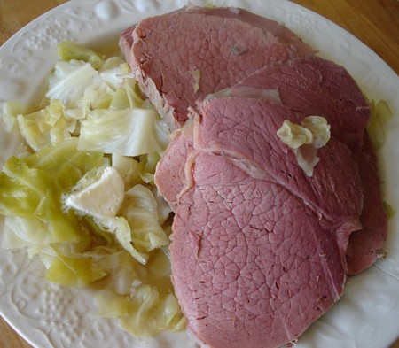
Corned beef— In the 19th century butcher shops which sold meat closed every weekend. Butchers had to keep the unsold meat fresh for two days. There were no refrigerators at that time, so some butchers had the clever idea covering meat with salt. The grains of salt were called "corn" in England, so the meat got the name "corned beef".

Slide 7
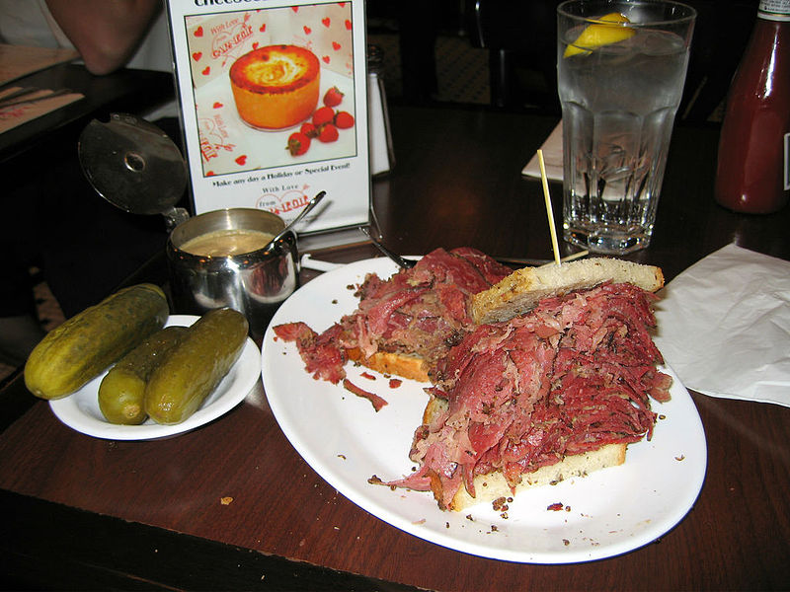
Pastrami (бастурма) is a kind of corned beef. The word "pastrami" came from Turkey. Originally it was "pastyrma", which means "being pressed" in Turkish.

Slide 8
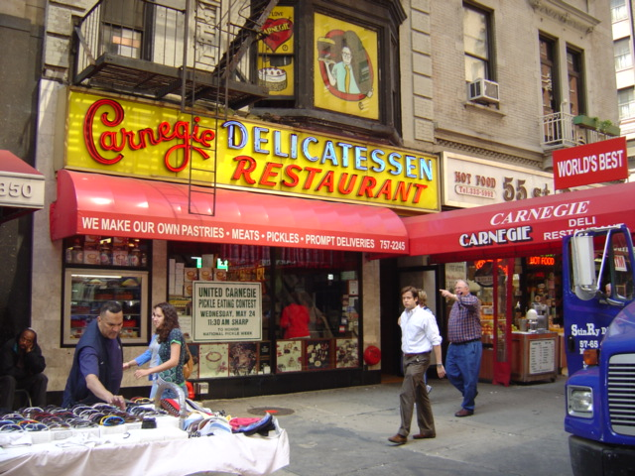

Slide 9
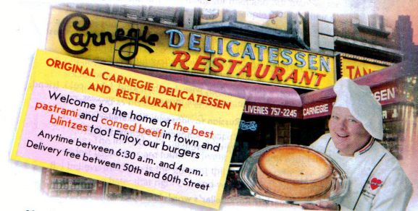
Olga and the friends arrive at the restaurant. Look at the pictures and say what kind of restaurant the Carnegie Deli is.

Slide 10
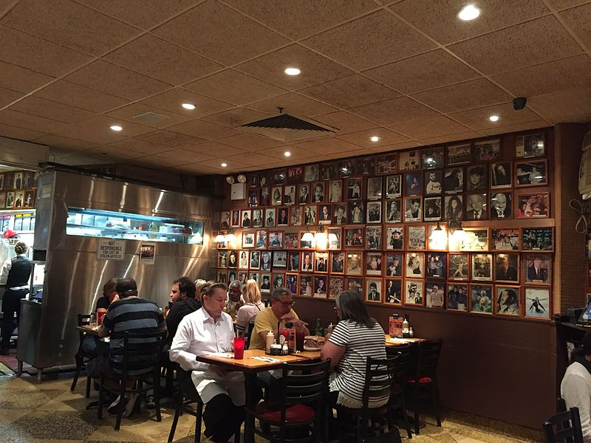
What are the people whose pictures you can see on the walls?

Slide 11
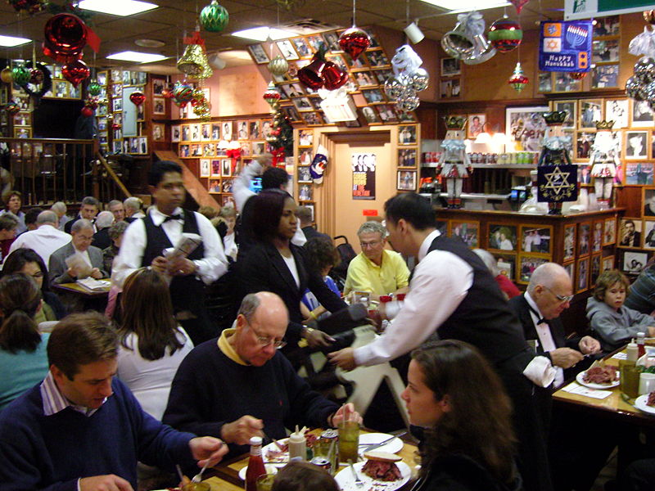
What is the short word for "hamburger"?

Slide 12
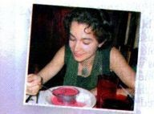
What is the girl in the picture eating?
Is the "deli" a Russian restaurant?

Slide 13
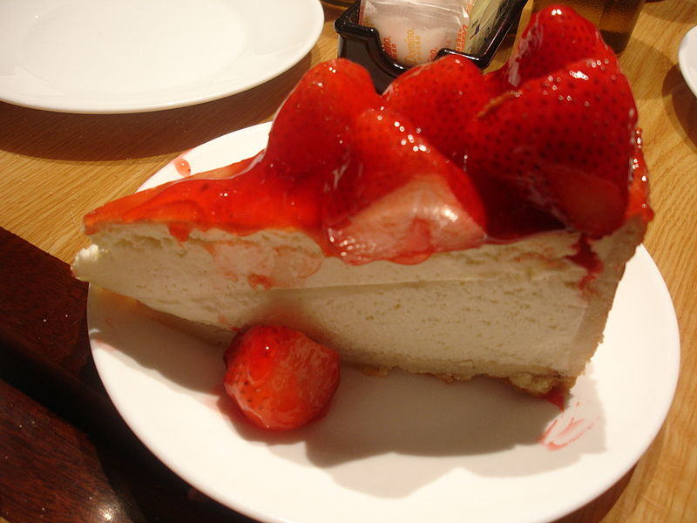
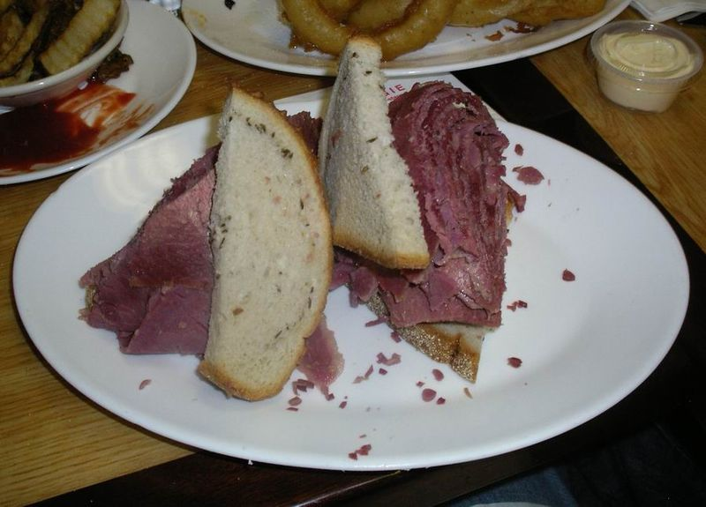
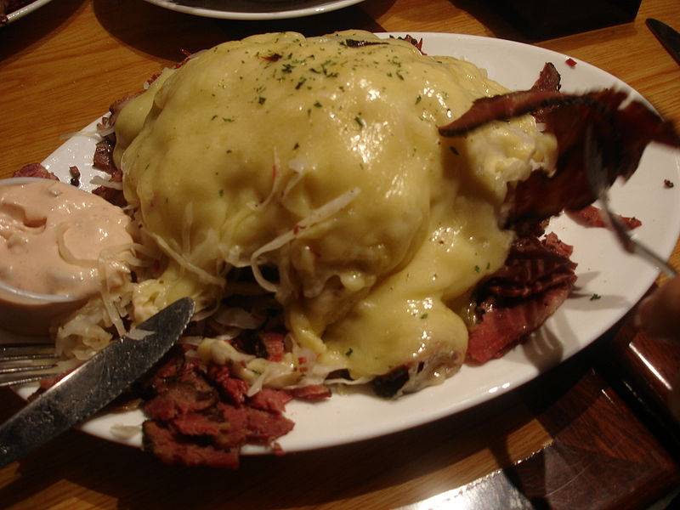
What kind of food can you get in this restaurant?
Will Misha, Mark and Rob find something that each of them likes in the deli?
A slice of Strawberry Cheesecake
A corned beef sandwich
A Reuben sandwich
A pastrami sandwich

Slide 14
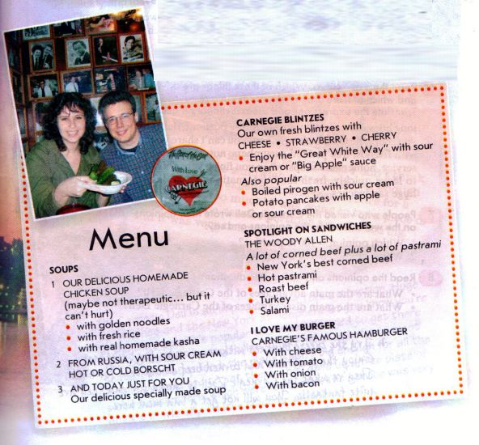
Look through the extracts from the menu and find as many Russian words and dishes as you can.

Slide 15

What are your emotions today? Choose one statement and write it.
- Our lesson was good.
- My mood is excellent!
- I could help my friends.
- I worked very well.
-I was interested in the lesson.
-I leaned a lot of information.
- I worked badly.
- My mood (настроение) is bad.
- My knowledge (знания) is bad.
- The theme was not interesting for me.
- I have negative emotions.

Slide 16
Homework
Learn new words by heart
WB – ex. A,B p. 18
Misha is telling his friends about some of his favourite Russian dishes. Match the dish with the description. Get ready to describe Russian dishes to your friends in the next lesson.

Slide 17
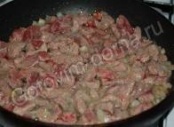
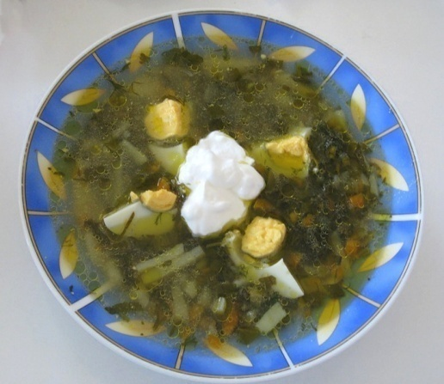
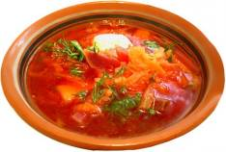
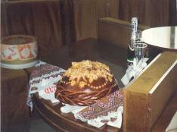
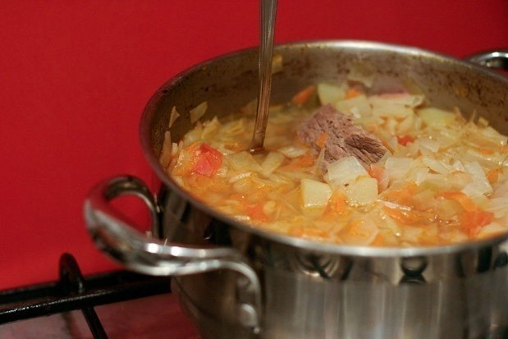
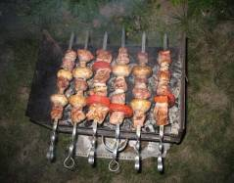
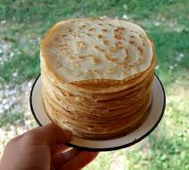
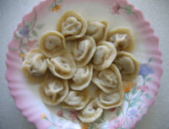
Lesson 11.RuSSIAN CUISINE
beef Stroganov
Sorrel-based green borscht
borscht
karavay
shchi.
shashlik (kebab)
blinis
pelmenis

Slide 18
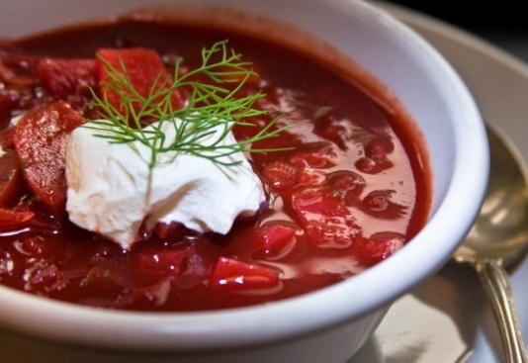
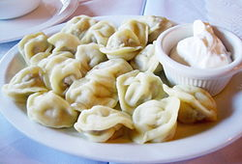
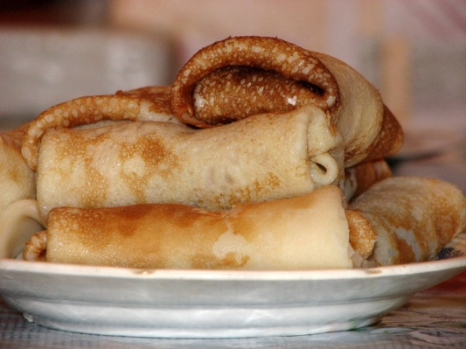
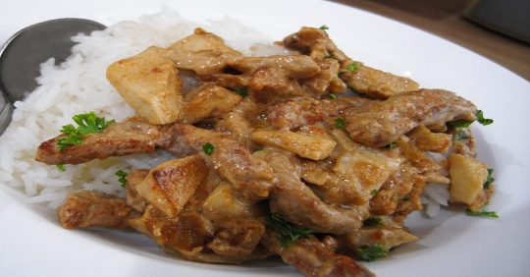
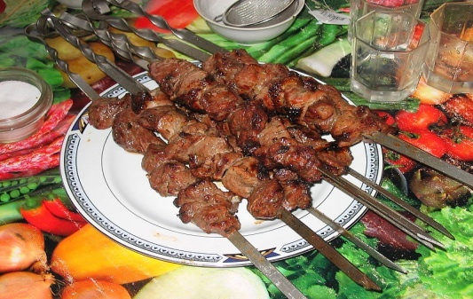
Pelmeni
 | It's one of the most popular dishes in Russia. The recipe — was created at the end of the 18th century. It's a kind of soup, which got its name from its main ingredient — beetroot. Nowadays it's made with cabbage, potatoes, carrots, tomatoes and meat. On hot summer days it's even better with no meat in it, just vegetables, fresh cucumbers, eggs, onions and greens.
 | These are a favourite Russian dish. They are made of dough and meat and then they can be frozen and kept in the fridge for a long time. They are served with butter, sour cream, vinegar or tomato ketchup. You can buy them in the shops too, but the ones you buy can't be compared with the real homemade version.
 | Traditionally, mothers-in-law bake these for their sons-in-law at Easter, and they also used to be made for poor people and pilgrims. They should be thin, brown, and round and look like little suns. They are usually eaten with sour cream, jam, cheese and black or red caviar.
 | The recipe was invented in a St Petersburg cooking competition in the 1890s. It won the first prize and was named after the Stroganov family, whom the cook was working for. This dish traditionally consists of beef, onions, mushrooms and sour cream.
 | The dish originates from the Caucasus. No picnic or outdoor party can do without this wonderful dish. It's meat marinated in herbs, onions and wine. Then the meat is put on skewers and cooked on an open fire.
 | It's really delicious, small round bread. Bread used to be the most important food in Russia, and no dish was eaten without it. That's why bread is still so important to people in Russia. They used to decorate it with leaves and flowers.
Вorscht
Blini
Beef Stroganov
Shashlik
Karavay

Slide 19
Употребление артикля с cуществительными
breakfast, lunch, tea, dinner
Как правило, эти существительные употребляются без артикля.
Breakfast in this hotel is from 7 a.m. till 10 a.m.
Если перед этими существительными есть описательное определение, употребляется неопределенный артикль.
You can have a good dinner there.
Если имеется лимитирующее определение, то употребляется определенный артикль.
I'll never forget the dinner we had in that little cafe in Chelyabinsk. — Я никогда не забуду ужин в том маленьком кафе в Челябинске.

Slide 20
Fill in the gaps. Use the, a or no article.
1. ... dinner is served.
2. I never have ... breakfast. I'm not hungry in the morning.
3. ... dinner we had in that cafe was disgusting.
4. Let's have ... lunch in the garden.
5. It was ... best dinner I've ever had.
6. I wasn't hungry because I had had ... big lunch.

Slide 21
What are your emotions today? Choose one statement and write it.
- Our lesson was good.
- My mood is excellent!
- I could help my friends.
- I worked very well.
-I was interested in the lesson.
-I leaned a lot of information.
- I worked badly.
- My mood (настроение) is bad.
- My knowledge (знания) is bad.
- The theme was not interesting for me.
- I have negative emotions.

Slide 22
Homework: Project p. 36.
Imagine that you have just spent a couple of days in New York. Write about your first impressions. Use the plan to help you. You can also use the material from this unit.

Slide 23

GOOD BYE!!!
GOOD BYE!!!

Slide 24
Источники информации
1.К.И. Кауфман, М.Ю. Кауфман Английский язык: Счастливый английский.ру/ Happy English.ru: Учебник англ. яз. для 9 кл. общеобраз. учрежд. - Обнинск: Титул, 2008
2.К.И. Кауфман, М.Ю. Кауфман Английский язык: Счастливый английский. Ру/Happy English.ru: Рабочая тетрадь№1 для 9 кл. общеобраз. учрежд.-Обнинск: Титул, 2016г. http://www.championstamp.com
www.wookieehut.com
www.americanfoodsgroup.com
http://www.carnegiedeli.com/
http://en.wikipedia....i/Carnegie_Deli
http://www.howstuffw...question298.htm
http://www.roadfood....0/carnegie-deli
http://www.artipot.c...of-fastfood.htm
http://helpguide.org
http://www.waytoruss...ussianFood.html
http://en.wikipedia.org/wiki/Pelmeni - information about pelmeni
http://en.wikipedia.org/wiki/Blintz - information about blintz
http://en.wikipedia.org/wiki/Borscht - information about borsch
http://en.wikipedia.org/wiki/Shashlik - information about shashlik
http://en.wikipedia....Beef_Stroganoff

